Slide 1
AWS VPC Peering Using Ubuntu EC2
Complete Explanation of Services, Configuration, and Networking
Student Name: ADITYA SHUKLA
Course: Cloud Computing Lab

Slide 2
Introduction
Cloud Computing: On-demand delivery of IT resources over the internet.
AWS: Leading cloud provider offering scalable infrastructure.
Networking in AWS: The backbone of cloud connectivity.
VPC (Virtual Private Cloud): A logically isolated section of the AWS cloud where you launch resources.

Slide 3
Project Objective
•
Create two isolated VPC environments.
•
Launch Ubuntu EC2 instances in each.
•
Establish VPC Peering connection.
•
Enable private communication between instances.
•
Verify connectivity using Ping and SSH.

Slide 4
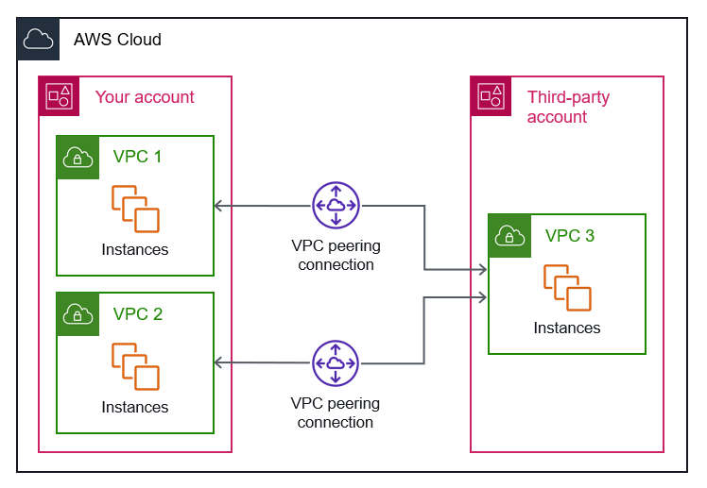
Architecture Diagram

Slide 5
Amazon VPC
A VPC provides a virtual network dedicated to your AWS account.
•
Isolation: Logically separated from other customers.
•
Control: Full control over IP ranges, subnets, and routing.
•
Public vs Private: Distinguish traffic flow.

Slide 6
CIDR Block
Classless Inter-Domain Routing (CIDR) defines IP address ranges.
Example: 10.0.0.0/16 provides 65,536 IPs.
Rule: VPC Peering requires non-overlapping CIDR blocks to avoid routing ambiguity.

Slide 7
Subnet
A segment of the VPC's IP range.
•
Public Subnet: Routes traffic to Internet Gateway.
•
Private Subnet: Isolated, no direct internet access.
•
Requirement: Instances reside in subnets.

Slide 8
Internet Gateway (IGW)
A VPC component that allows communication between the VPC and the internet.
Without an IGW, instances are private and cannot reach the web.
Note: VPC Peering uses internal AWS backbone, not the IGW.

Slide 9
Route Table
A set of rules (routes) used to determine where network traffic is directed.
•
Local Route: Communicates within the VPC.
•
Peering Route: Directs traffic to the peer VPC CIDR.
•
Internet Route: Directs traffic to 0.0.0.0/0 via IGW.

Slide 10
Security Groups
Virtual firewalls at the instance level.
•
Stateful: Return traffic is automatically allowed.
•
Rules: Define Inbound (what enters) and Outbound (what leaves).
•
Lab setup: Allow SSH (22) and All ICMP.

Slide 11
Amazon EC2
Elastic Compute Cloud (EC2) provides resizable compute capacity.
In our lab: Used to host the Ubuntu OS and act as the network end-point.

Slide 12
Ubuntu Server
A Linux-based OS preferred for its stability, security, and open-source nature.
Provides powerful networking tools like ping, ssh, and ip addr.

Slide 13
Key Pair
Used to securely log into EC2 instances.
•
Public Key: Stored on AWS.
•
Private Key (.pem): Stored on your machine.
•
Benefit: More secure than traditional passwords.

Slide 14
IP Addressing
Public IP: Accessible from the internet.
Private IP: Used for communication within the network (e.g., Peering).
Security: Communication between VPCs should always use Private IPs.

Slide 15
VPC Peering
Networking connection between two VPCs allowing routing via private IP addresses.
Traffic stays within the AWS global backbone.
Key Fact: Peering is NOT transitive.

Slide 16
Implementation Steps
1.
Create VPCs and Subnets.
2.
Attach Internet Gateways.
3.
Launch Ubuntu instances.
4.
Configure Security Groups.
5.
Create and accept Peering connection.
6.
Update Route Tables.
7.
Test connectivity.

Slide 17
Networking Flow
Packet Traversal:
Source Ubuntu -> Subnet -> Route Table -> Peering Connection -> Route Table -> Destination Subnet -> Destination Ubuntu

Slide 18
Verification
Key Commands:
•
ping <private-ip>: Verify connectivity.
•
hostname -I: Check private IP.
•
ip addr: Detailed network interface view.

Slide 19
Common Errors
•
Route table not updated.
•
Overlapping CIDR blocks.
•
Security groups blocking ICMP.
•
Peering request not accepted.

Slide 20
Advantages
•
Secure private communication.
•
Low latency, high speed.
•
No additional hardware required.
•
Cost-effective.

Slide 21
Limitations
•
Non-transitive routing.
•
No overlapping CIDRs allowed.
•
Manual route updates required.

Slide 22
Applications
•
Multi-tier applications (App layer peering to DB layer).
•
Development and Production environment separation.
•
Hybrid cloud connectivity.

Slide 23
Summary
Successfully demonstrated VPC Peering using Ubuntu EC2.
Configured VPCs, updated route tables, and validated private network traffic flows using AWS best practices.

Slide 24
Conclusion
AWS Networking components work together to provide secure, private, and scalable infrastructure.
Understanding VPC Peering is essential for architecting robust cloud environments.

